Slide 1

Microsoft Teams
Tip Sheets for Training and Reference

Slide 2






Microsoft Teams @CW

Slide 3
Why Teams?
MS Marketing Truths
“Work remotely without feeling remote”
“The hub for teamwork in Microsoft 365”
“Discover a new way to work together”
“Achieve more together with Microsoft Teams”
“Nothing can stop a team”

Slide 4


Teams is integrated
  Outlook Calendar is in Teams
  MS 365 apps like Stream (CW private “YouTube”) accessed seamlessly
  CW on-line directory is within Teams
Leverage existing investments
  Microsoft 365 licenses already included for employees
  Use also with external business partners, volunteers, donors
  Groups can work on files together – Word, Excel, PowerPoint, etc.
  Use on PC, mobile devices, browser
Secure, compliant, easy to administer – supported by CW IT
Menu Buttons
Notifications & activity logs
Instant messaging
single or group
Collaborate in Teams & Channels
Connect to a meeting from the Calendar
Use the CW online directory and call a coworker
Files accessed recently easily available
Why Microsoft Teams @CW?

Slide 5
MS Teams
MS Teams does NOT require being on CWF network
You CAN invite people outside of cwf.org to Teams meetings to join via web / any device. They do NOT need to be Office 365 users or Teams users.
You can install and use Teams on a smart phone or tablet if on-the-go / your PC is unavailable.
Modern new smart phones came with headsets you can use for listening or speaking using an audio jack.
IT can assist with procuring headset and/or cameras for divisions or users without laptops who will be using MS Teams – coordinate through the Service Desk as an “Other” New Equipment Request.
Not everyone has a license with a dial-in line, which incurs a monthly cost. If you expect recurrent dial-in needs, have a supervisor reach out to IT.
General Things to Know
Microsoft is retiring Skype in 2021, with Teams as the replacement.
MS Teams is the CW IT supported app for office chat, calling, virtual meetings, and collaboration.
CW Skype users should transition to Teams as soon as possible.
Microsoft Teams Info

Slide 6
Daily Work
Outlook
Teams
integrated
Productivity @CW Should Include Outlook and Teams Used Daily

Slide 7

Microsoft Teams Features

Slide 8
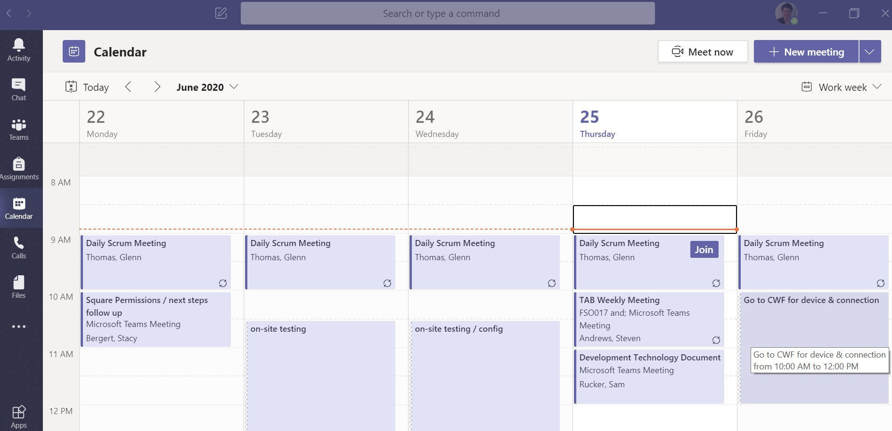
Upcoming teams meetings show the [Join] button
Microsoft Teams Calendar integrated with Outlook

Slide 9
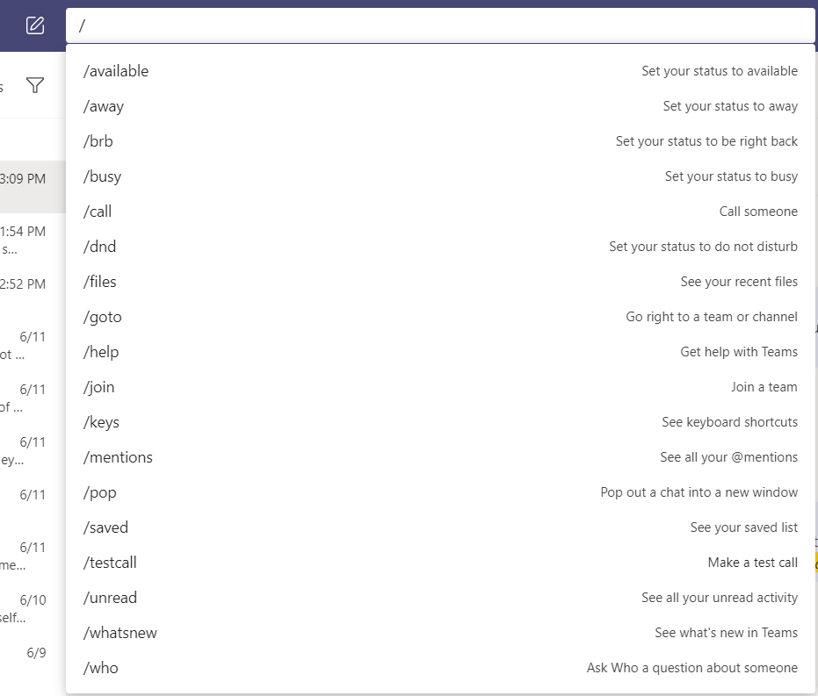
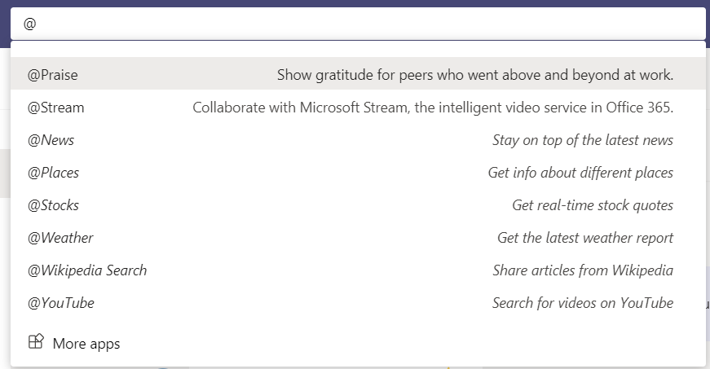
Search Box in Teams
Type in a keyword to look for a chat or team post
Type “/” to see available functions
  Use /testcall to test audio and video outside of a call or meeting
Type “@” to see apps/features
Microsoft Teams – Search & Command Box

Slide 10

Chat
Instant Messaging in Teams includes Advanced Features

Slide 11
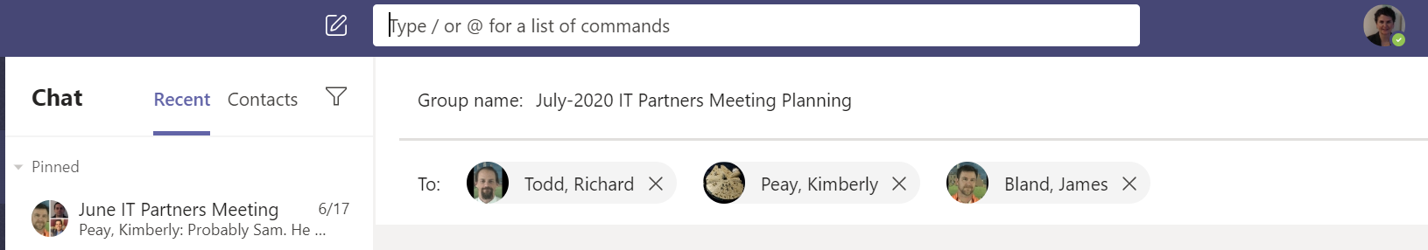
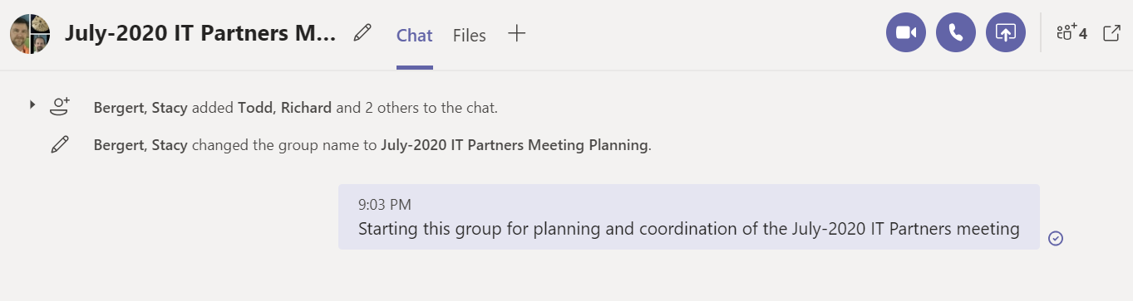
Click the pen on paper icon next to the Search box to start a new chat
Add participants, auto-filling from our org directory. Teams will extend an existing chat or create new if first combination.
If a new group chat (>1 person), you can add a name as you create the chat
Start typing and hit return to start the chat.
Microsoft Teams – New Chat

Slide 12
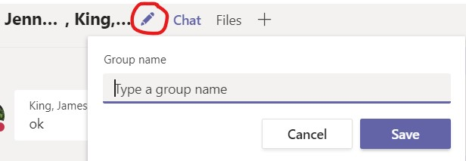
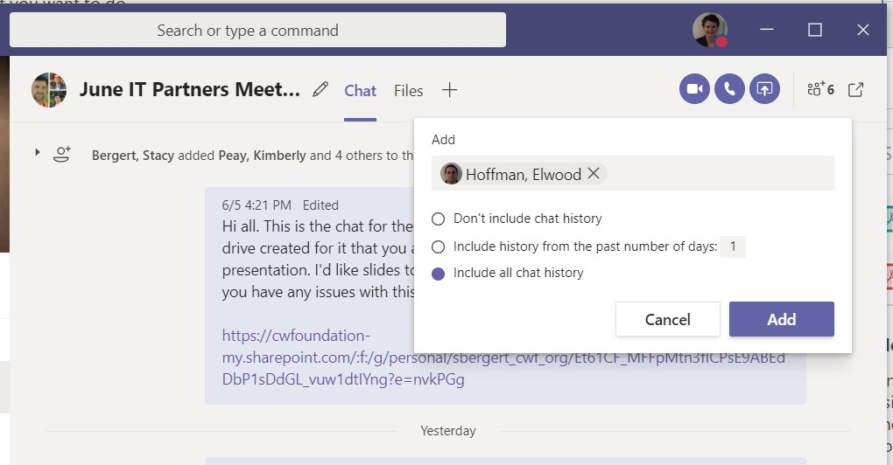
From Within a Chat:
Click the pencil to name your group chat for ease of finding it in your list
Add participants to a Group Chat, and then choose what they see (Private Chats Remain Private)
Pop out the chat to a new window (ease of multitasking)
Start Video, Call, or Sharing right from your chat
Type the name for group, then click [Save]
Microsoft Teams – Chat Features

Slide 13
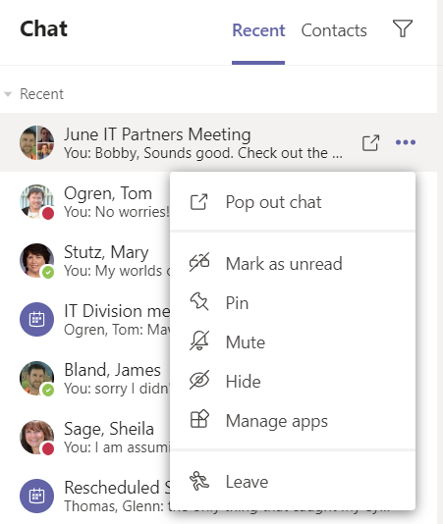
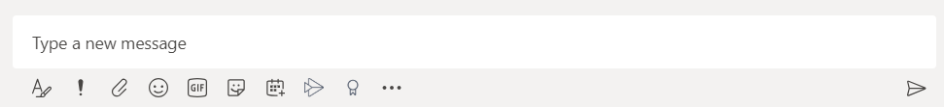
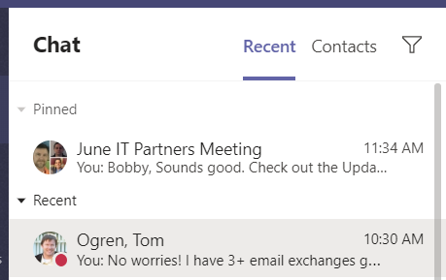
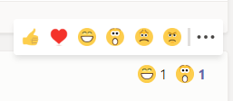
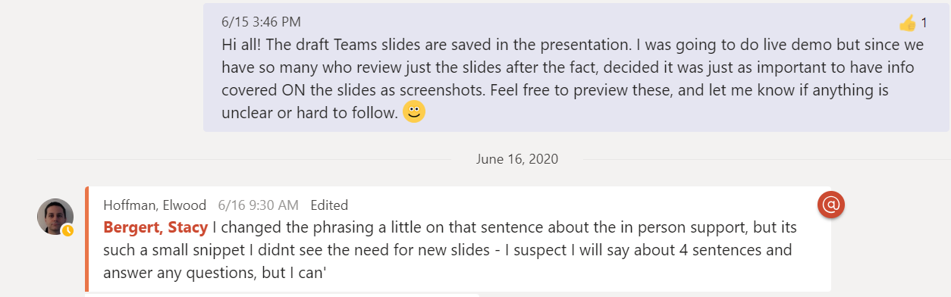
From your Chat List, use the … to:
Pop out to a new window
Pin to place the chat at the top
Format Chat Text
Click the format icon to have more control over your chat or post. Most format options available in Word are found using format, and format also gives you a place to draft prior to posting/sending.
Hover on chat, and choose an emoji to provide feedback or acknowledge it
@mentions – call out a person or team with @ followed by the name of the person OR team to cause notifications to person or team
(reformats to show their name as a link)
Microsoft Teams – Pin, Format, and Acknowledge Chats

Slide 14
Meetings
Initiate from:
Outlook,
Teams,
Meet Now

Slide 15
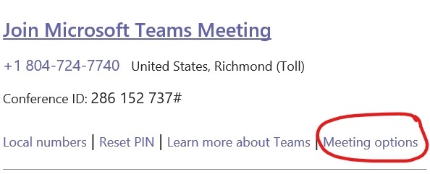
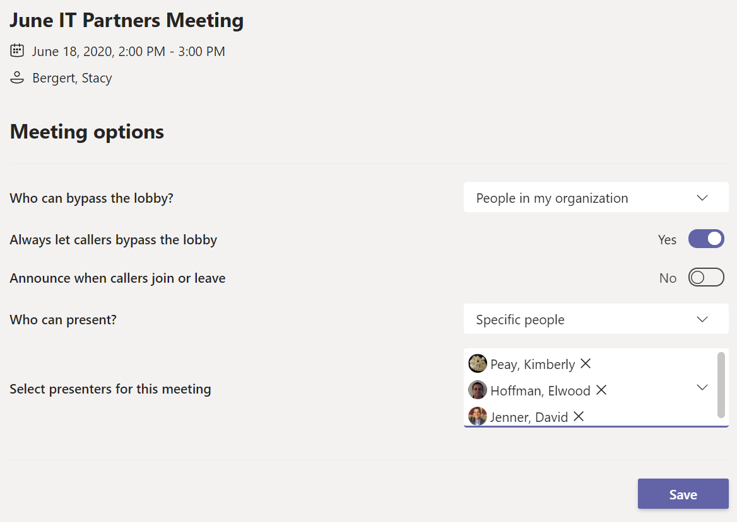
Launches to your web browser:
ADVICE: Set up in advance of the meeting
Control who bypasses the lobby (can include Everyone if appropriate)
Control whether callers can bypass the lobby
Control who presents in a meeting –
  ONLY these people will be able to take control in the meeting.
  One of the dropdown options is Only Me if you need to completely lock down the meeting
Microsoft Teams – Meeting Options (Before a Call)

Slide 16
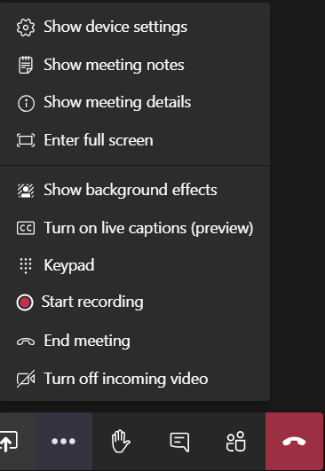











Record meetings
Recordings can be uploaded to Stream (Office 365 app) and made available to groups of users OR to all of CW.
Move your mouse or touch the screen of your device (if cell, tablet) and the control bar above shows on your screen.
Options include:
  Toggle your video on/off
  Toggle your microphone on/off
  Share / Stop Sharing
  More Actions
  Raise your hand / Lower your hand
  Chat
  Attendee List
  Hang Up
More Actions – Use for:
Meeting notes or details
Controlling your background
Start/Stop Recording
Microsoft Teams – Meeting Options (During a Call)

Slide 17
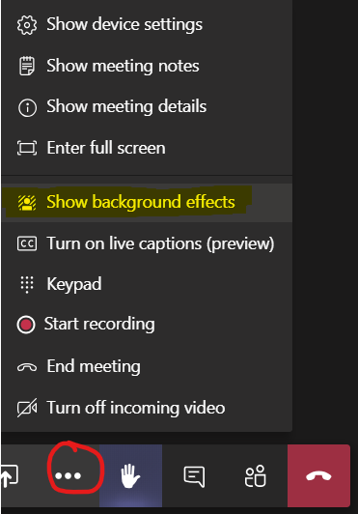
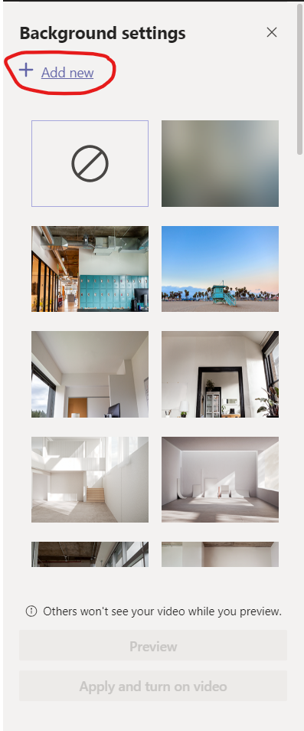
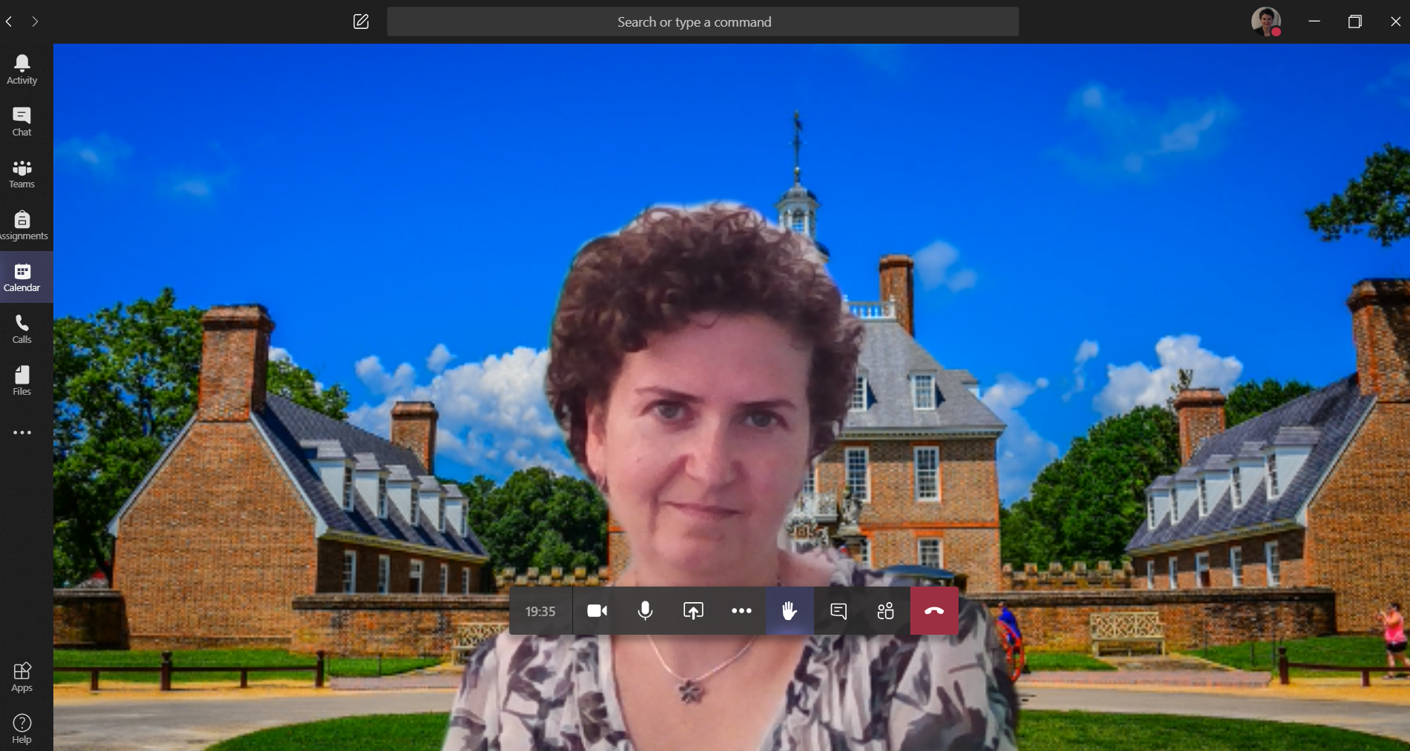
Choose from the list of stock backgrounds available
The Blurred image blurs your background
Click +Add new to add your own or custom photo (gets added to bottom of the list)
Click Preview to see the background in test mode
Click Apply to turn it on
Click the Circle with Slash to turn off backgrounds
“add new” background applied
Microsoft Teams – Change your Background

Slide 18
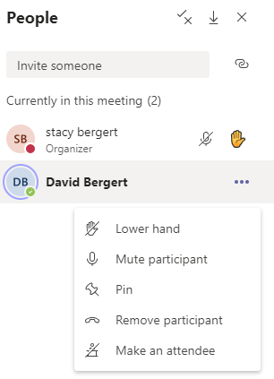
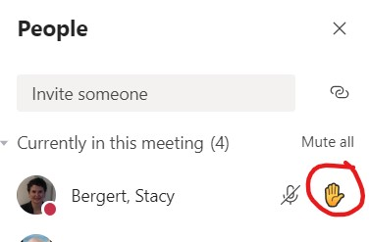

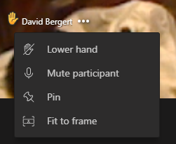

Raise Your Hand
Available in MS Teams Meetings
Raise hand to get a speaker’s attention to ask a question OR to take polls during a meeting
Raised Hand can be seen on a person’s image (yellow hand in corner) OR in the participant list.
Hands of participants can be lowered by presenters OR by the participant themself
Presenters can control hands as well as muting, pinning, etc. through both the view box of the attendee AND the attendee list
Microsoft Teams – Raise Hand

Slide 19
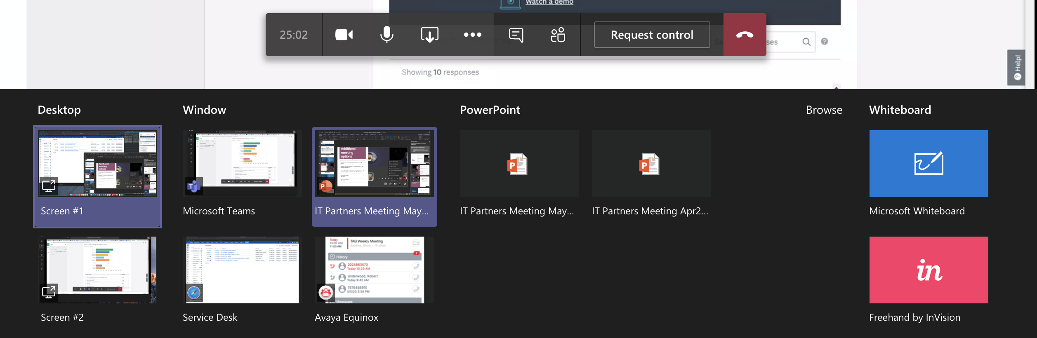
  Share an entire screen (monitor) using “Desktop”, with each monitor labeled as different Screen#s
  Share a file or document open as “Window”
  Share a PowerPoint explicitly – if recently opened choose from list; otherwise choose “Browse”
  Share or add additional apps such as Whiteboard which acts just like one in a conference room.
Microsoft Teams – Sharing on a Meeting or Call
Notes:
We DID include this slide only in the May session

Slide 20
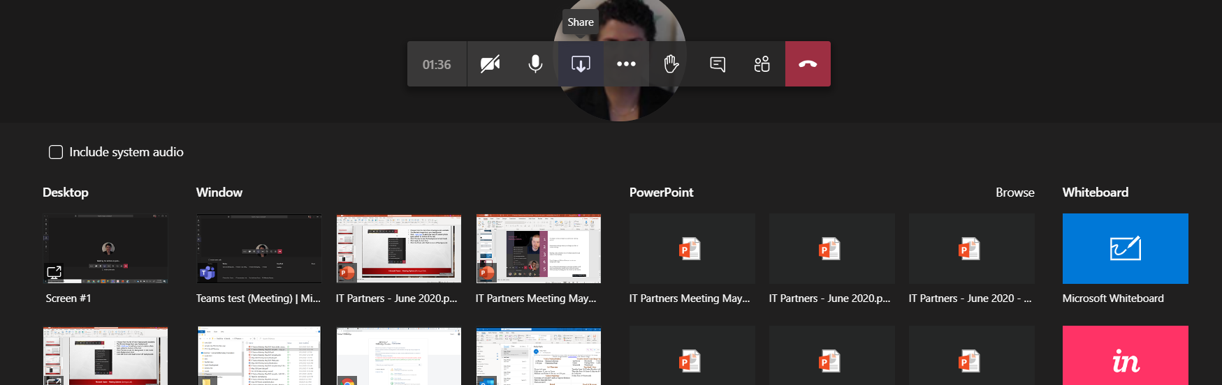
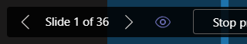
If presentation includes shared audio or video that you intend to play DURING the presentation (e.g., pre-recorded stream video or YouTube), be sure to click this checkbox before the item to share:
Presenting is Controlled with the Share Action on the Control Bar:
Can share a PowerPoint Presentation Window to share just that active window BUT presenting a PPT is cleaner choosing from under the PowerPoint listing which allows easier slide control and pass of control between Presenters
Others setup as presenters can Request Control when someone is sharing
Turn OFF ability for attendees to preview slides by clicking the eye
Click the eye icon toggle to show a slash through it to control attendee previews
Microsoft Teams – Sharing Presentations / Including Audio

Slide 21

Calling
Call coworkers directly from Teams using the Directory

Slide 22
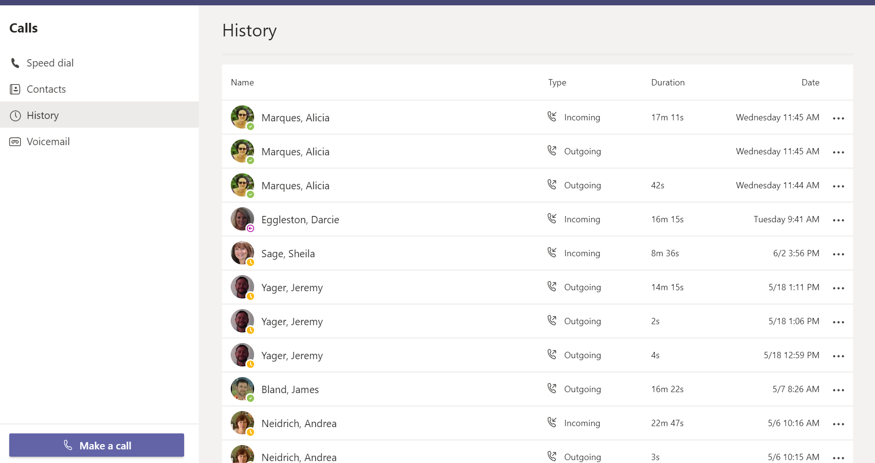
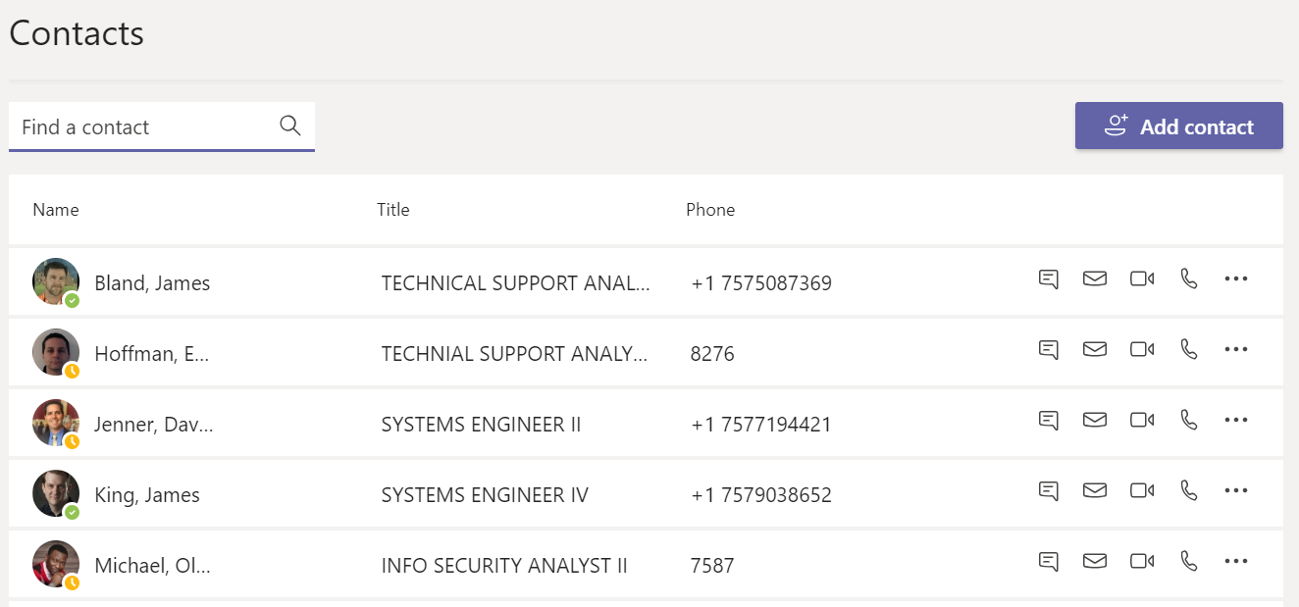
Can also turn on video, calling, or sharing directly from a chat
(no need for a new meeting if you’re all on the chat)
Microsoft Teams – Calling

Slide 23

Collaboration
Microsoft Tools are integrated, and Teams pulls it all together for ease

Slide 24



Draft
Team
Use when you know you will collaborate on docs and want a whole team to easily access this information, integrated with chats, and apps.
Website
Use when you need web-based collaborations or team websites
Use when just you (one) or only a few people need to work on a document.
Save drafts, work on documents until ready to share
Integrated with SharePoint – easier/more-intuitive interface
Integrated with Teams
Microsoft File/Collaboration Apps @CW

Slide 25
Teams
Channels
Teams are groups of people with shared purpose / who collaborate
Membership in Team can be private or public (within CW)
If you are not a member of a team, you WILL NOT see its contents, channels, etc.
You can be a member of up to 1000 different teams
Can have up to 200 channels per team
“General” is the default channel per team
Collaboration occurs within Channels
Channels are topics within a team
Can be private (available to subset of team members) or open to entire team
Notifications are by channel
“Posts” is the default tab for the channel
  Works like Chat
“Files” tab catalogs files shared in the channel; can Sync to OneDrive
You can add tabs to channels
  Share files
  Integrate different apps
Microsoft Teams Collaboration – Teams and Channels

Slide 26
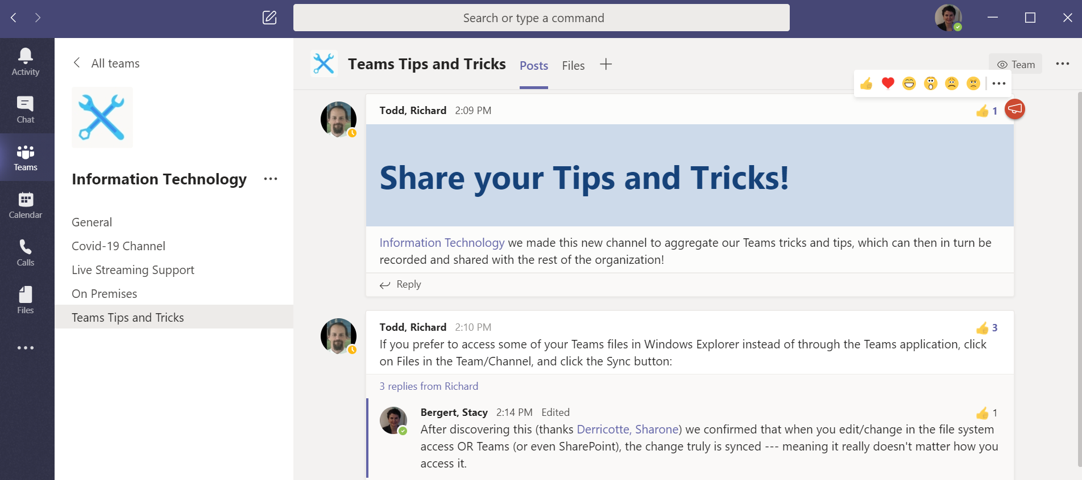
Posts tab: use for team communication (posts and responses) OR for Announcements (can limit to no responses)
Microsoft Teams Collaboration – Channel Posts

Slide 27
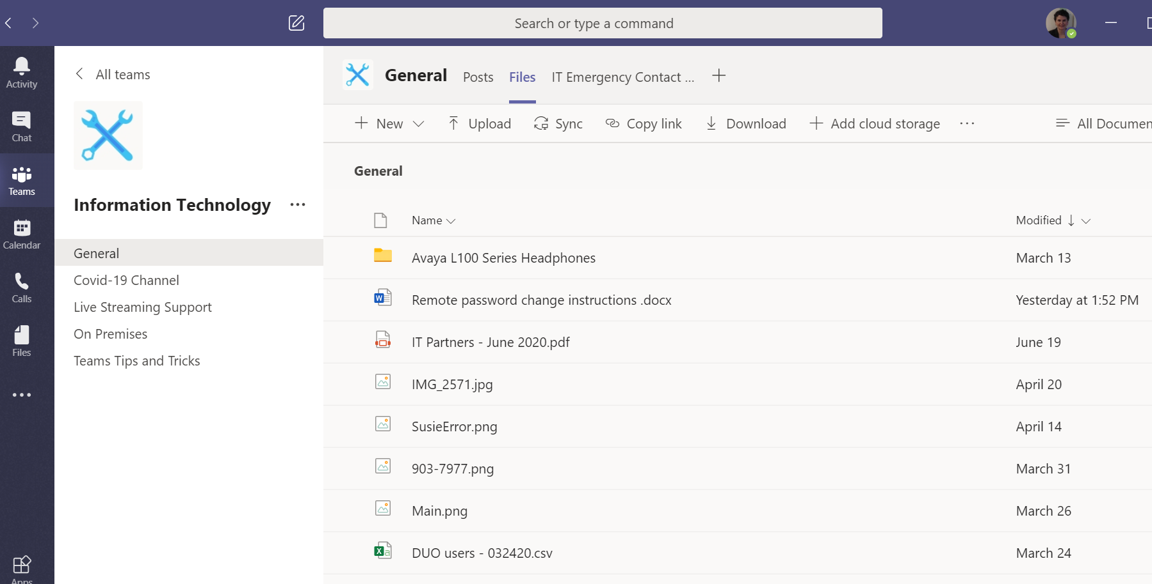
Add other tabs or app integrations as relevant to the team
Files tab shows files uploaded, created here, OR attached to a post in the channel.
Work right here OR Sync, Copy link
Microsoft Teams Collaboration – Channel Files

Slide 28
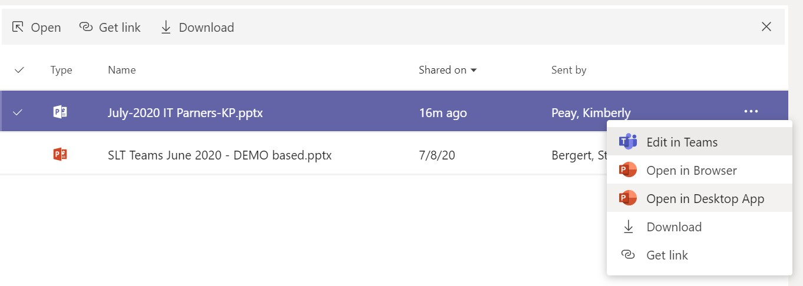
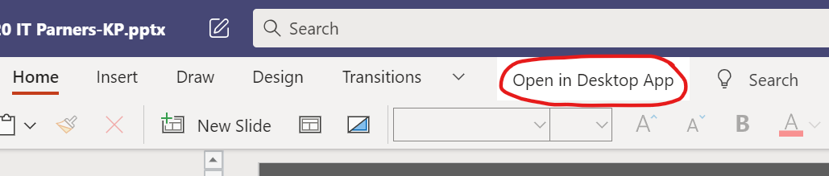
Work on files directly from the Files tab
Default will open the file in Teams
Click Open in Desktop App if you need advanced features OR want to work where you’re more comfortable
  This option is available before you open the file OR once you already have the file open in Teams
Anywhere you edit saves the file in Teams
Microsoft Teams Collaboration – Edit Files in Teams or Native App

Slide 29
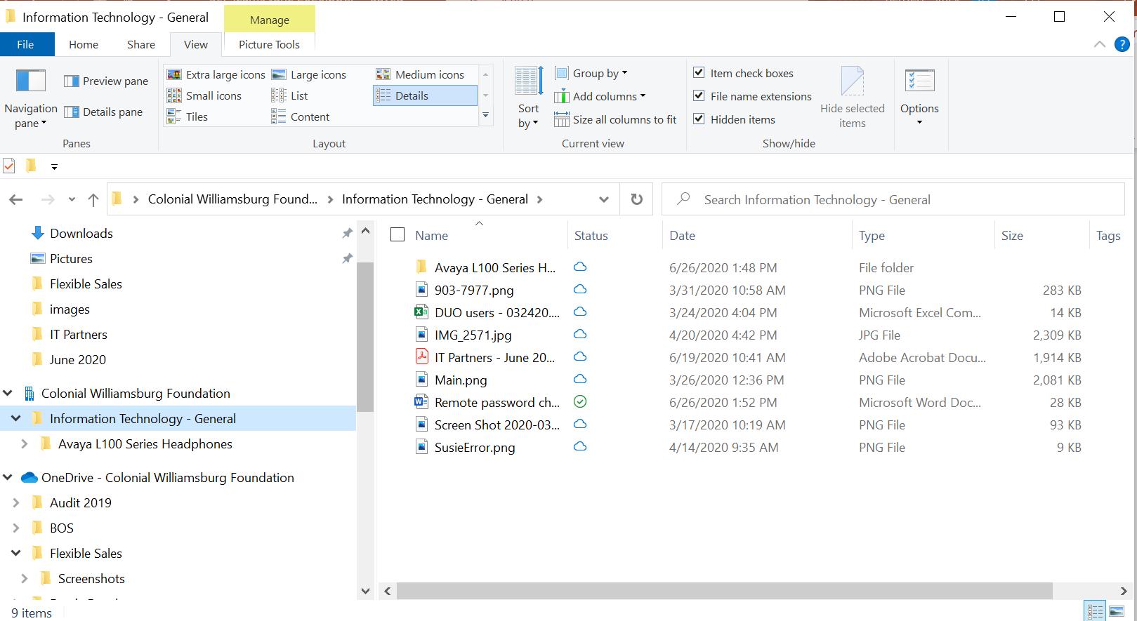

Click Sync on the files tab to generate a file explorer synchronized view for working with the files.
These are the SAME files as in Teams files.
Microsoft Teams – Collaboration / Work Where You’re Comfortable

Slide 30
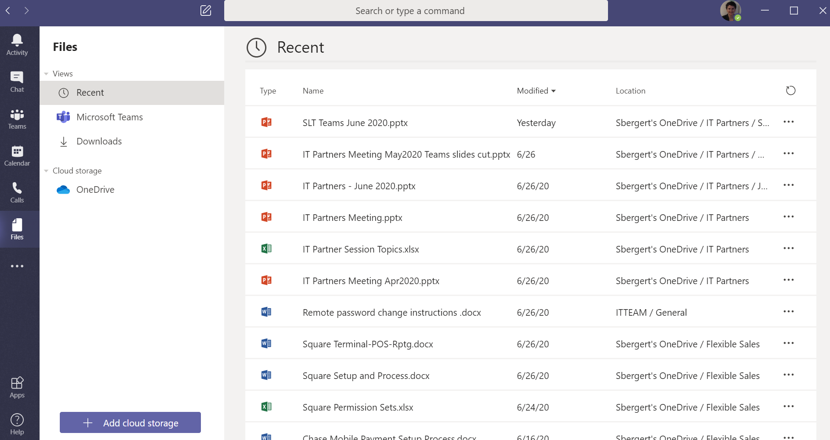
Microsoft Teams –Access your Recent Files, Teams Files (across channels), etc.

Slide 31
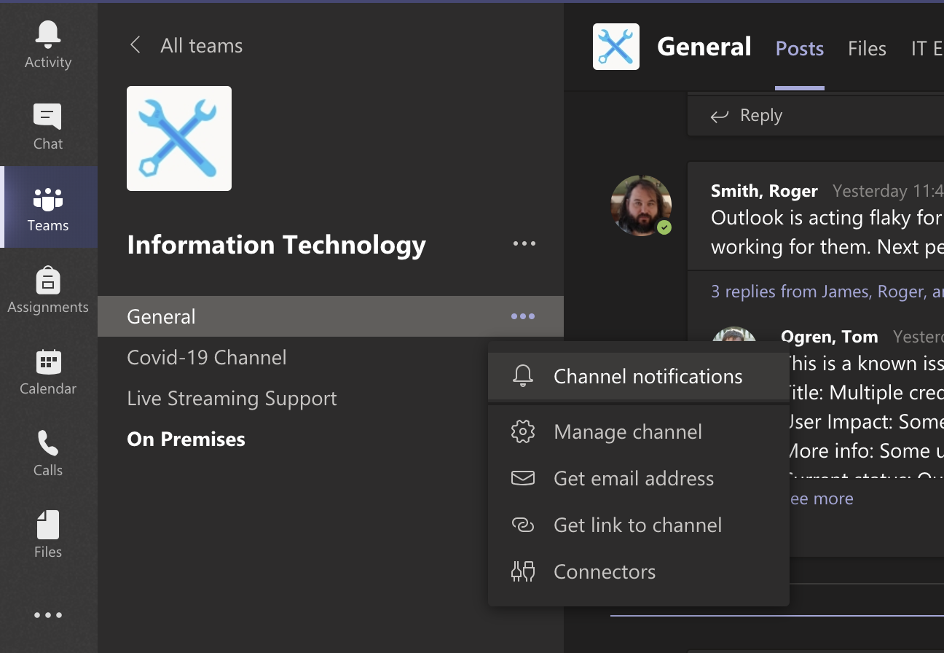
Microsoft Teams – Manage Channel Notifications

Slide 32
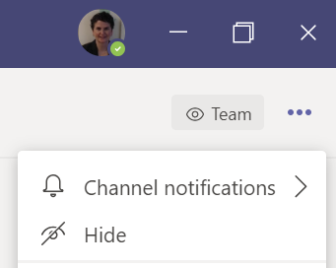
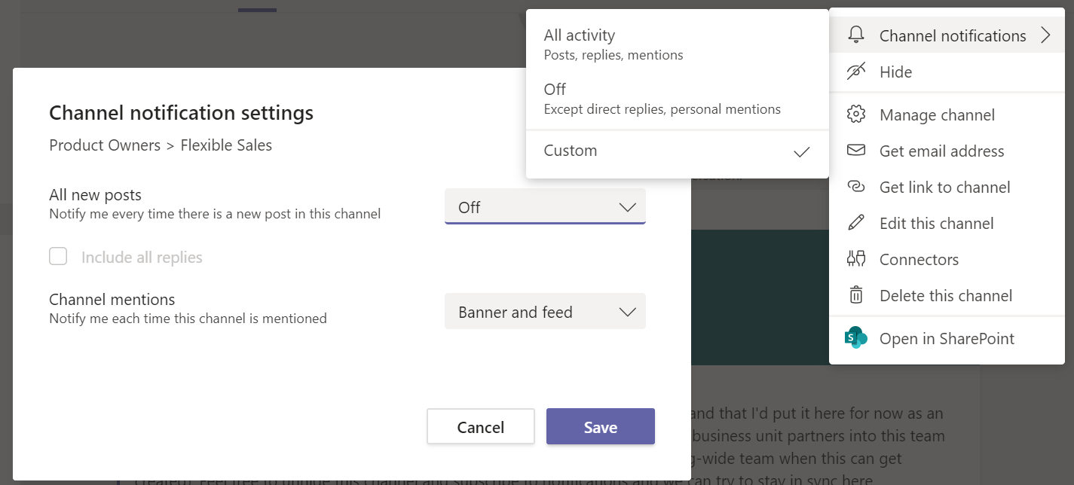
You are in control of your Channel Notifications.
Choose to know about ALL posts, include replies, or no notifications for posts
Choose whether to know about channel mentions
Feed -
show in Teams Activity
Banner -
desktop notification
  PC - bottom right
  MAC - top right
Microsoft Teams – Channel Notifications Specifics

Slide 33
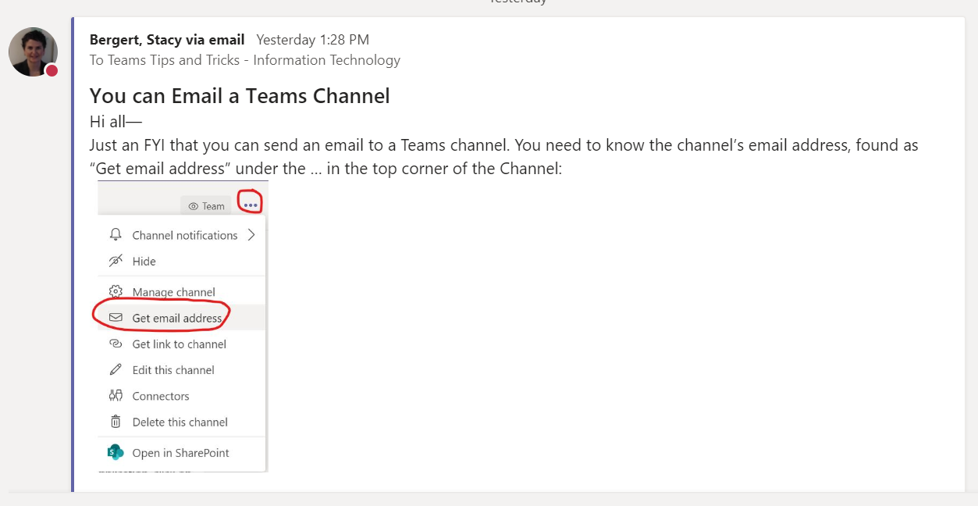
Send emails to Channel to track info more cleanly (e.g., than via email
Use Channels with your team to:
Avoid remembering with whom to communicate (Avoid accidentally forgetting people in To: or cc: )
Avoid email landing in junk folder OR accidentally read/ignored OR accidentally deleted
Avoid having to file or flag or add tasks for follow up and remembering how/where to search for email later because…
When the info or file is in your Team Channel, it’s already WHERE you need it with the RIGHT people able to access it
Microsoft Teams – Email to a Channel

Slide 34

RECAP:
Microsoft Teams
use Channels to
  Communicate
  Announce
  Seek Help
  Advise
  Provide Status / FYI
  Collaborate
Microsoft Teams – Recap (Channels Are Easier than Emails)

Slide 35

Want More Info/Training?
https://support.office.com/en-us/article/microsoft-teams-video-training-4f108e54-240b-4351-8084-b1089f0d21d7?ui=en-US&rs=en-US&ad=US
Microsoft Teams – Link to Training Videos

Slide 36



Questions?
ITCommunications@cwf.org

