Slide 1

IT Partners
Teams Addendum

Slide 2

MS Teams
Tips

Slide 3
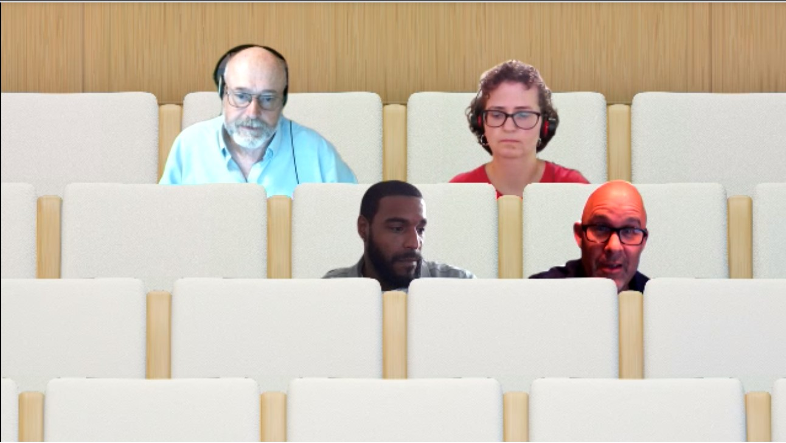
For Large Meetings, Try “Together Mode”
Included in recent updates from MS Teams
Click the … on the meeting control bar, and select “Together Mode” to change your display of participants
Best for Teams meeting with
  4+ people using video cameras
  no need for presentations, screen sharing, or white boards
  multiple people will be speaking or sharing
If you don’t yet see together mode:
  Make sure you’re using the app
  Check your Settings that you’ve got “Turn on new meeting experience” turned on.
  - New meetings and calls will open in separate windows.
  - Requires restarting Teams.
In “Together Mode” everyone is placed into the same setting, and everyone using this mode in the meeting sees the same view allowing for same experiences, facial cues (“looking” at a neighbor), and social “interactions” during the meeting (try tapping someone on the shoulder)

Slide 4

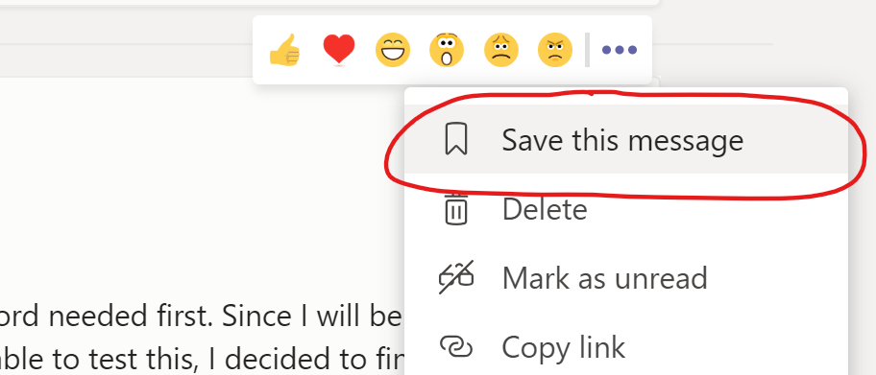
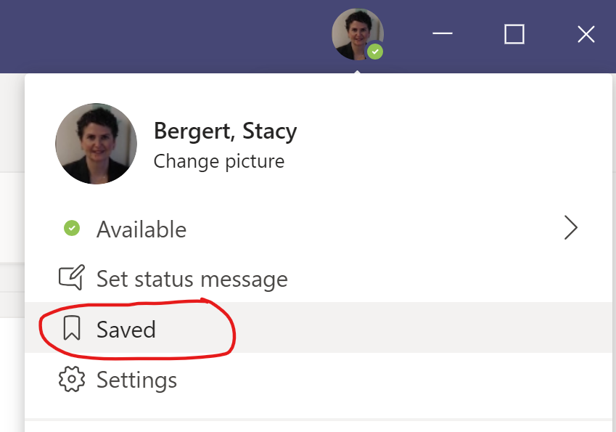
Bookmark Important Messages
You can bookmark any message so it’s easy to find later on
Click on the three ellipse in the top corner of the message and select Save this message
Find Saved Messages under your profile
Or use the /Saved (slash command in search) to see the saved list

Slide 5
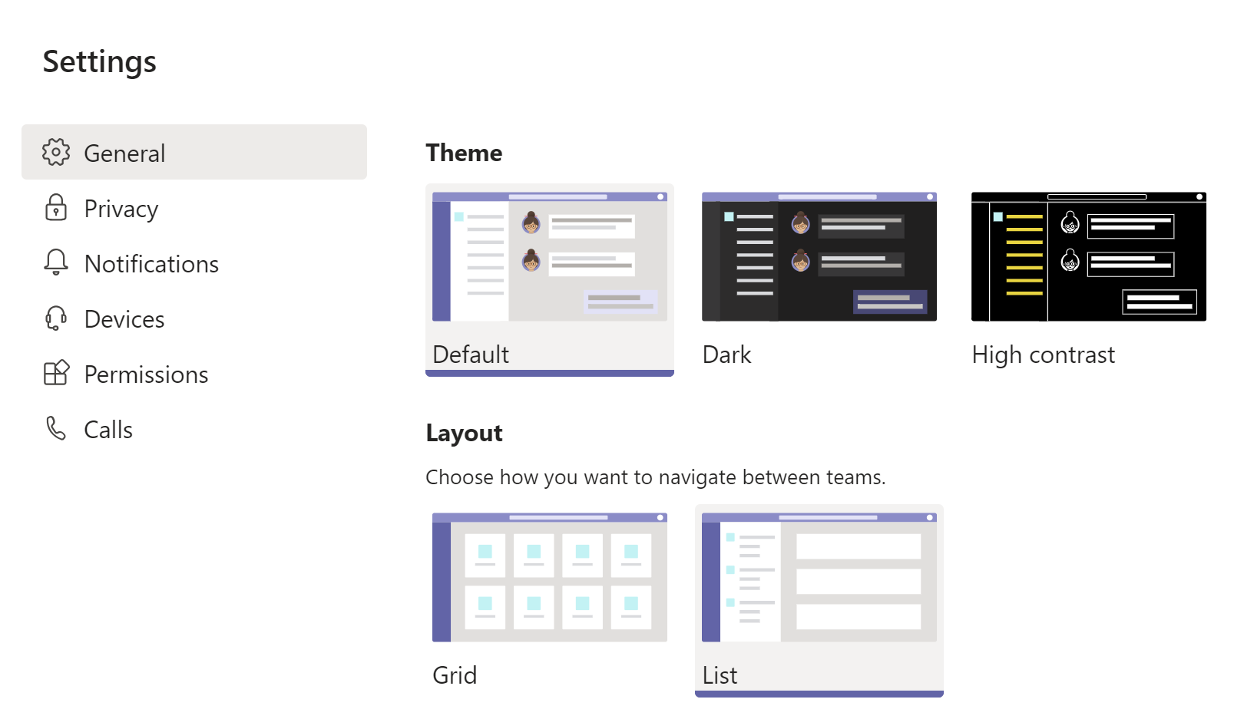
Show Teams in List View instead of Grid
Under your profile picture, choose Settings and General,
From there, specify your layout as “List” instead of “Grid” to keep you from having to click into your teams listings in a clumsy way
Once you are showing your teams and channels in List mode, you can also PIN your important channels, so they show at the top of the list

Slide 6
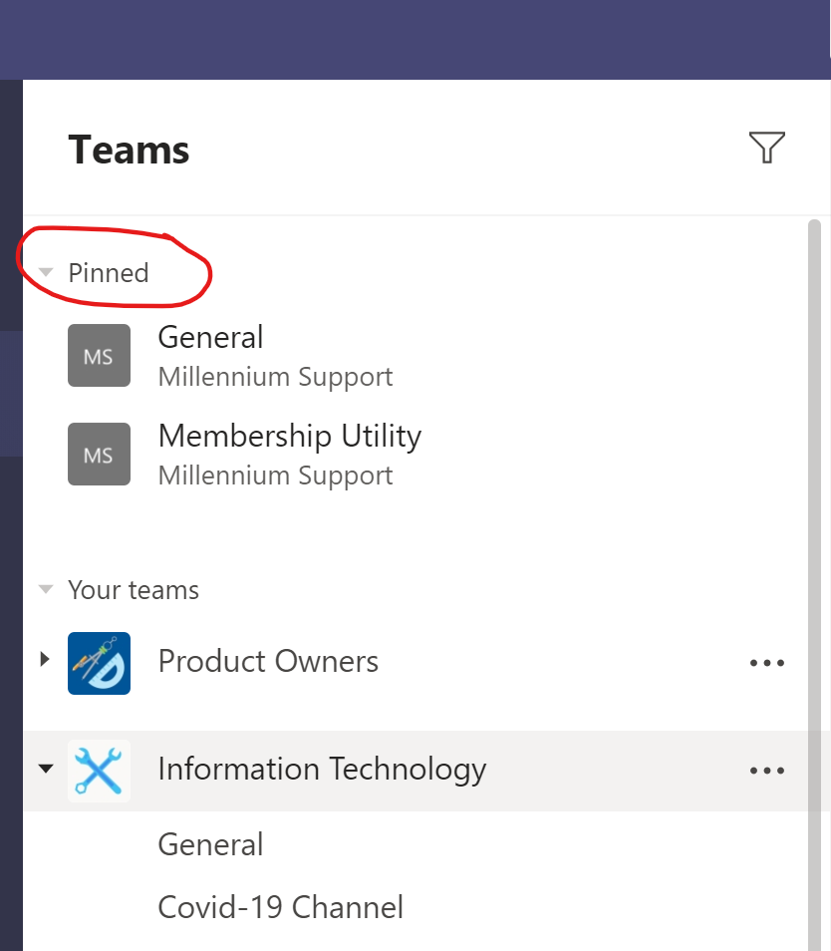
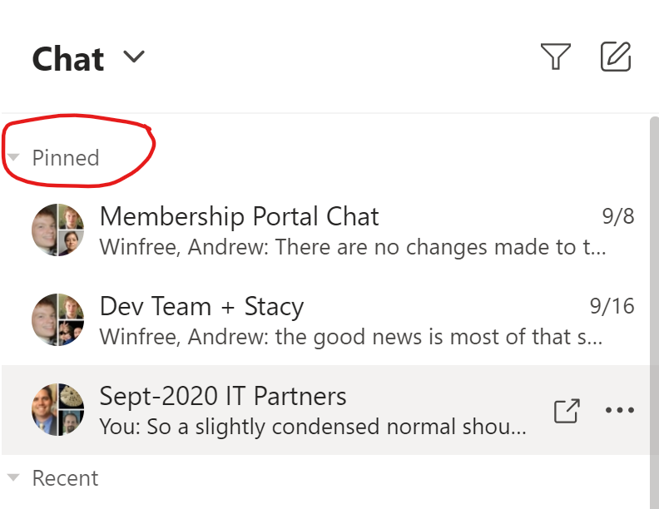
Pin Channels and Chats Regularly Used
Cleanest to use Pinned Channels is when showing your Teams in list view (see prior tip)
When viewing your channels, click the … ellipses in the top corner and choose Pin
The pinned channels will show up in a “pinned” section at the top of your teams list.
You can do the same with any Chat, and when viewing your chat list, the Pinned ones show on the top.

